Slide 1
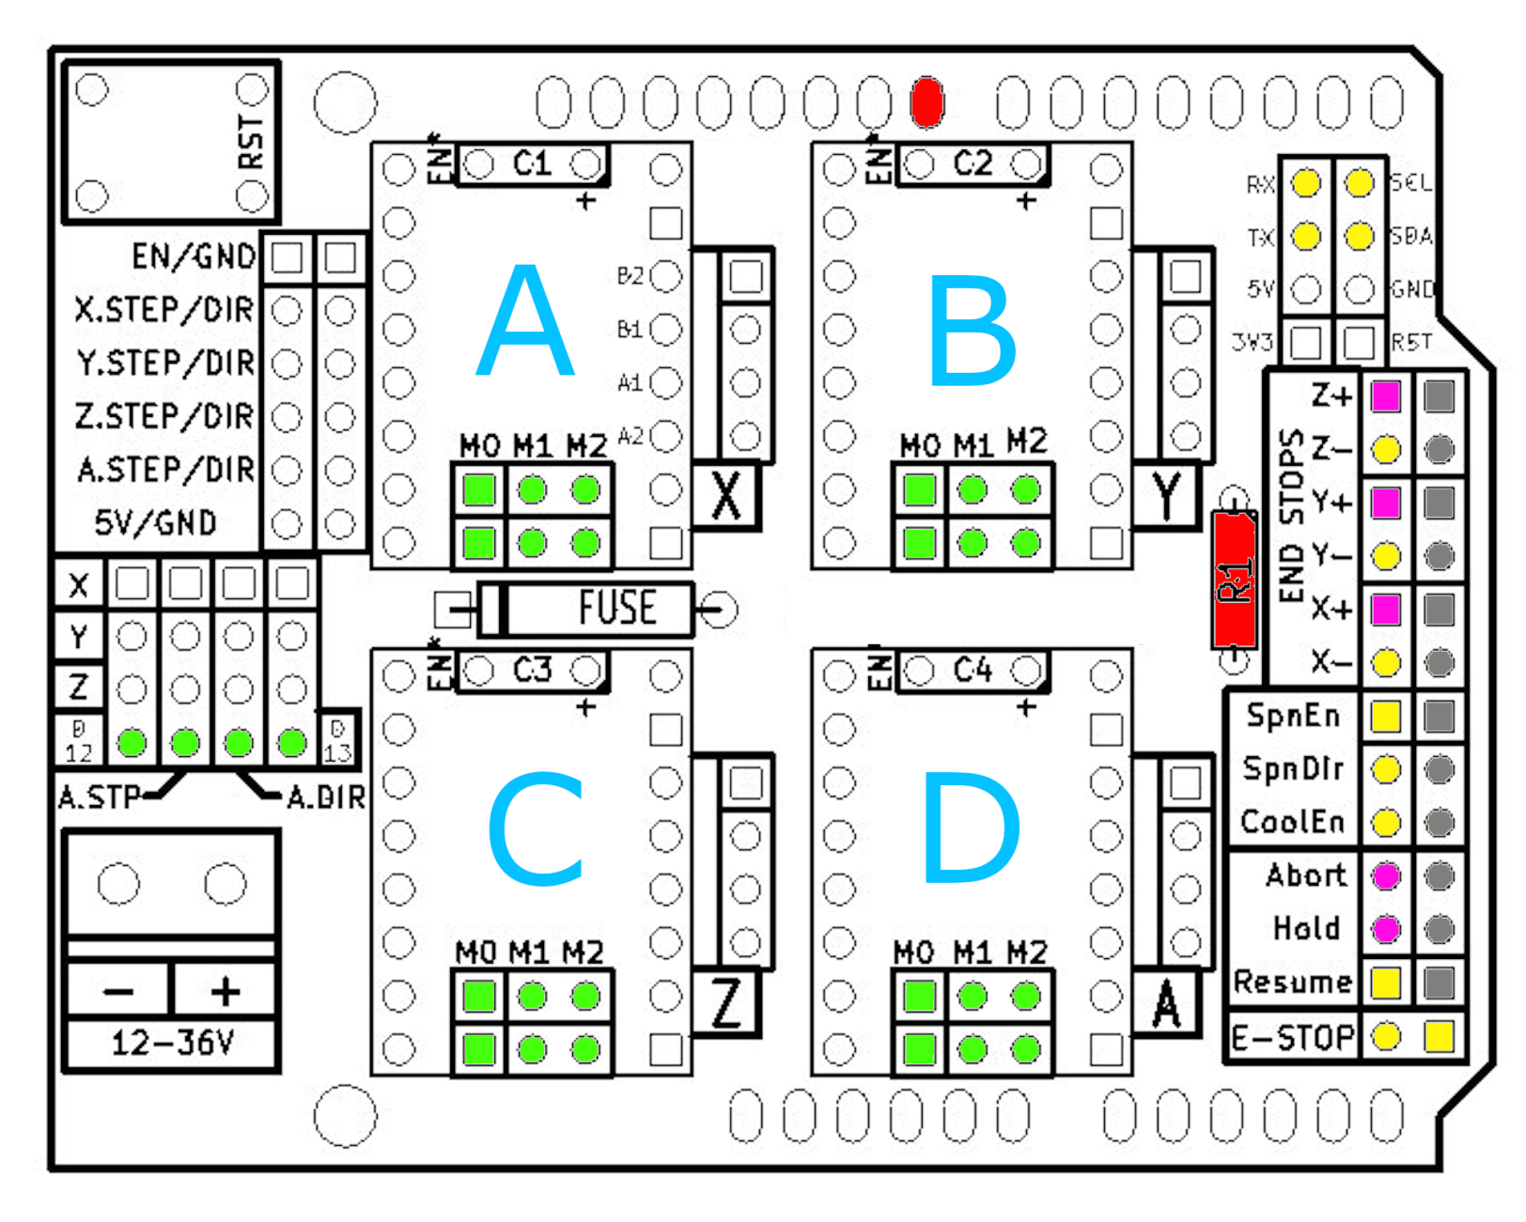
Beeper
Servo 2
Servo 1
External
Reset
Insert
Jumper
Hardware
Modification
Fixed Function
Fexible
Function
Stepper
Indentification

